Slide 1

DATABASES AND APPLICATIONS
SUBJECT CODE : UQ23CA653A
Samyukta D Kumta
Computer Applications

Slide 2
DATABASES AND APPLICATIONS
Database Recovery Model-PITR
The point-in-time recovery (PITR) is a feature that allows you to restore a database to a specific moment in time.
Full Backups
Incremental or Differential Backups
Recovery Process
Transaction Logs

Slide 3
DATABASES AND APPLICATIONS
Database Recovery Model
Full Backups:
Periodically, full backups of the database are taken. These backups capture the entire state of the database at the time they were created
2.Incremental or Differential Backups:
In addition to full backups, some systems also support incremental or differential backups. These backups capture only the changes made to the database since the last full backup, reducing backup time and storage requirements.

Slide 4
DATABASES AND APPLICATIONS
Database Recovery Model
3.Recovery Process:
In the event of data loss or corruption, PITR involves restoring the database to a specific point in time using the combination of full backups and transaction logs

Slide 5
DATABASES AND APPLICATIONS
Database Recovery Model
4. Transaction Logs:
The transaction log is a critical component of a database management system (DBMS) that records all changes made to the database.
It serves as a mechanism for ensuring data consistency, durability, and recoverability in the event of system failures or crashes.
The transaction log plays a crucial role in ensuring the ACID (Atomicity, Consistency, Isolation, Durability) properties of database transactions.

Slide 6
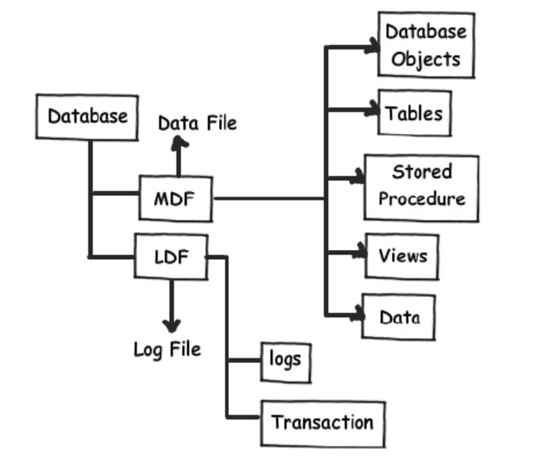
DATABASES AND APPLICATIONS
Database Recovery Model-Log File

Slide 7
DATABASES AND APPLICATIONS
Database Recovery Model
The transaction log captures the following types of information for each database transactions
Transaction Start and End
Data Modifications
Transaction Identification
Undo Information

Slide 8
DATABASES AND APPLICATIONS
Database Recovery Model
Transaction Start and End:
The log records the beginning and end of each transaction, indicating when a transaction starts and when it commits or rolls back.
Data Modifications:
Any changes made to the data in the database, such as inserts, updates, and deletes, are logged. This includes both the old and new values of modified data.

Slide 9
DATABASES AND APPLICATIONS
Database Recovery Model
3. Transaction Identification:
Each transaction is uniquely identified in the log, typically by a transaction ID or sequence number. This allows for tracking and correlating changes made by individual transactions.
4. Undo Information:
In addition to recording the changes made by transactions, the log also stores information necessary to undo those changes if the transaction needs to be rolled back. This includes the before-images of modified data.

Slide 10
DATABASES AND APPLICATIONS
Database Recovery Model
Database Recovery models define how the database system manages and logs changes to data, enabling recovery to a consistent state after a failure.
Three common database recovery models
Full Recovery Model
Simple Recovery Model
Bulk-Logged Recovery Model:

Slide 11
DATABASES AND APPLICATIONS
Full Recovery Model
In the full recovery model, the DBMS maintains a detailed log of all transactions in a transaction log file.
This model provides the highest level of data protection and allows for point-in-time recovery.
Transaction log backups are required to prevent the transaction log from growing too large.
It's suitable for databases where data loss must be minimized, and point-in-time recovery is critical, such as financial systems or systems with strict regulatory requirements.

Slide 12
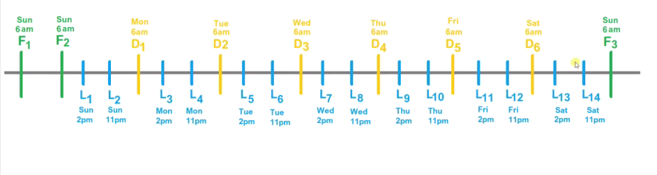
DATABASES AND APPLICATIONS
Full Recovery Model
Full Backup
Differential Backup
Transaction log backup.

Slide 13
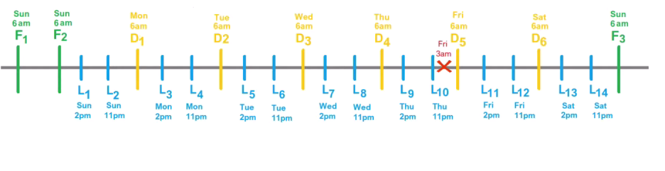
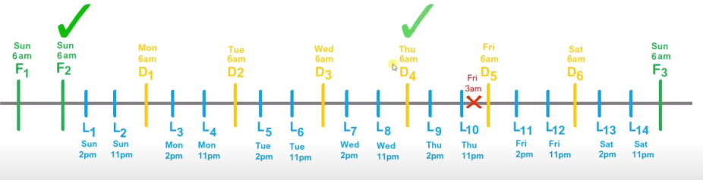
DATABASES AND APPLICATIONS
Full Recovery Model

Slide 14
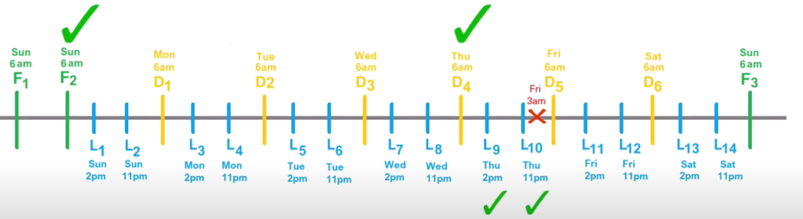
DATABASES AND APPLICATIONS
Full Recovery Model

Slide 15
DATABASES AND APPLICATIONS
Simple Recovery Model
In the simple recovery model, the transaction log is periodically truncated or cleared, usually after each checkpoint.
This model provides less data protection compared to the full recovery model because it does not support point-in-time recovery.
It's suitable for databases where data loss is acceptable, and point-in-time recovery is not required, such as development or testing environments.

Slide 16
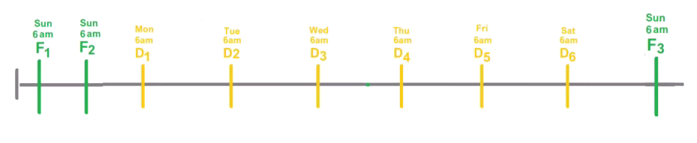
DATABASES AND APPLICATIONS
Simple Recovery Model

Slide 17
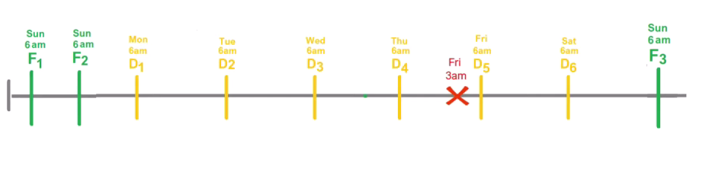
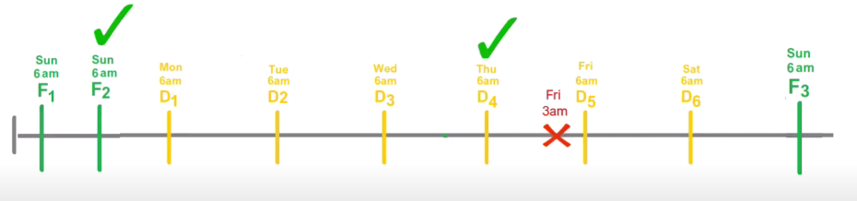
DATABASES AND APPLICATIONS
Simple Recovery Model

Slide 18
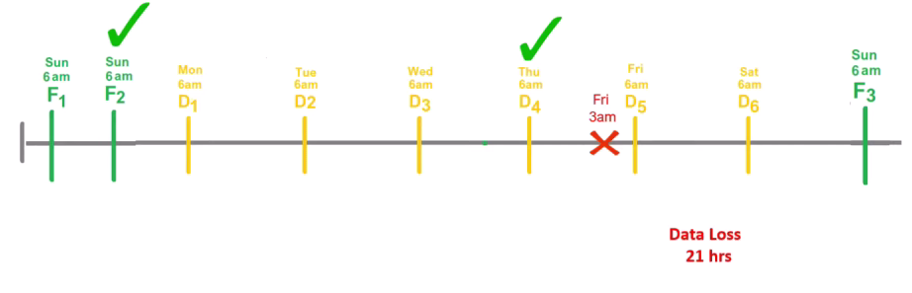
DATABASES AND APPLICATIONS
Simple Recovery Model

Slide 19
DATABASES AND APPLICATIONS
Bulk-Logged Recovery Model
The bulk-logged recovery model is a variation of the full recovery model optimized for bulk operations.
Bulk operations, such as bulk inserts or large data modifications, are minimally logged, which reduces the size of the transaction log.
However, it limits the ability to recover to a specific point in time during bulk operations.
It's suitable for databases that perform large-scale bulk operations and can tolerate limited data loss during these operations.

Slide 20
DATABASES AND APPLICATIONS
Recovery Model
Choosing the appropriate recovery model depends on factors such as the criticality of the data, the required level of data protection, the frequency of bulk operations, and resource constraints.
It's essential to understand the characteristics and trade-offs of each recovery model and select the one that best meets the requirements of your application and organization.
The regular backups and testing of recovery procedures are essential components of any database recovery strategy.

Slide 21

THANK YOU
Samyukta D Kumta
Department of Computer Applications
samyuktad@pes.edu

